Slide 1
Council of NIH-Funded Training Programs (CTP) Meeting
Clinical Research Training Center
Office of Training Grants
November 4, 2015
10:00-11:00 a.m.
Erlanger Auditorium
Facilitators
Mario Castro, MD, MPH and John Russell, PhD

Slide 2
Clinical Research Training Center
Office of Training Grants
Agenda
Updates
Grants Library
Diversity Language
Training Grants Database
NIH xTRACT/New Data Tables
2. New NIH Biosketch (Becker Library)
3. Open forum – input from audience/participants

Slide 3
Clinical Research Training Center
Office of Training Grants
Grants Library
OTG’s Grants Library houses awarded grant applications, standard grant language and templates.
NIH Grants
Institutional Grants (ICTS, Siteman, etc.)
Private Grants (PCORI)
Standard Grant Language/templates (Facilities, RCR, diversity language, LOS)
Since the launch of the (old) Sharepoint site last March, the site has had more than 1,000 views
Notes:
We are working on soliciting others (DOD, NSF, build up are career development inventory)

Slide 4
Clinical Research Training Center
Office of Training Grants
Grants Library (WUSTL Box)
Piloting WUSTL Box (previously on SharePoint)
Easier access across the university
More user-friendly
Better search features
To access (must have active WUSTL key):
https://wustl.box.com/wustlgrantslibrary
For more advanced search functions contact OTG

Slide 5
Clinical Research Training Center
Office of Training Grants
Grants Library (WUSTL Box)
Security
Only includes grants from PIs willing to share their materials
PIs fill out a waiver agreeing to share content
OTG removes all sensitive budgetary info/items requested by PI
Only those with WUSTL key can access the site
WUSTL Box Security questions, contact John Bailey, Sr. Systems Engineer: jwbailey@wustl.edu
Notes:
John Baily – IT is here to answer any questions that anyone may have about security.

Slide 6
Clinical Research Training Center
Office of Training Grants
Grants Library (WUSTL Box)
PI’s interested in sharing successful grant applications (over last 5 years) please contact the OTG
Looking to add: DOD, NSF, Career Development Awards, Private
“Visibility request” submitted to the CIO to help promote the site
Notes:
Visibility Request: Executive Committee meets in December – should hear more at that point. In the meantime, the site is available to anyone with a WUSTL Key. We will be piloting the site initially so please contact Betsy with concerns/suggestions.

Slide 7
Clinical Research Training Center
Office of Training Grants
Grants Library: Current Inventory
Grant Type | Number | Grant Type | Number
F30 | 3 | R25 | 4
K01 | 2 | R42 | 1
K08 | 5 | RF1 | 1
K12/KL2 | 3 | T32 | 6
K22 | 1 | T35 | 1
K23 | 6 | U10 | 1
K99/R00 | 1 | P30 | 1
R01 | 25 | LRP | 4
R03 | 2 | Private | 2
R18 | 1 | Institutional | 3
R21 | 7 | TOTAL | 80
Resources
Recruitment/Retention Plan
RCR Examples
IDP
Resource Sharing Plan
Facilities/Resources
LOS (examples)
Biosketch (examples)
Proposal Templates
Notes:
We will periodically solicit additional grants/resources to make sure this is up to date.

Slide 8
Clinical Research Training Center
Office of Training Grants
Diversity Language Template
Language drafted for the required “Recruitment and Retention Plan to Enhance Diversity” section
Can be found in “Standard Language” section of Grants Library (WUSTL Box)
Reviewed by: DBBS, ODP, OFA, OPA, HR, CRTC
Designed to serve as a template/overview of all diversity efforts at the University. Not mandatory to use this language
PI/PDs can pick and choose the recruiting and/or retention efforts that are most suitable for their programs
Contacts for each program are included if you would like to find out more information

Slide 9
Clinical Research Training Center
Office of Training Grants
Training Grants Database (Update)
In December 2014, the OTG along with the Vice Chancellor of Research and members of the CTP Training Grants Database Working Group submitted an IT Investment request to the Office of the CIO
Requested a centralized database that can:
Store mentor/trainee info needed for datatables
Generate required documents such as Biosketches/OS
Link to other databases such as PubMed and HRMS

Slide 10
Clinical Research Training Center
Office of Training Grants
Training Grants Database (Update)
Received conditional funding approval from the CIO (!)
Resubmitted application for September IT Investment Deadline, answering questions re: Scope, Project Roles, Coordination with Faculty Database request
Working with WU Faculty Database group to make sure the required fields are included
Have viewed several potential vendors (CTP Database Working group)
Notes:
The $ is there and this project will happen.
Our project is dependent on the faculty database as there are overlapping fields. We are working with that group to make sure the correct fields are included – they hope to identify potential vendors earlier winter – start next spring. Final product????
Vendors viewed: SciMed (Curvita) – the only vendor that specifically focuses on Training grant reporting, WU Pediatrics Profile System, Digital Measures.

Slide 11
Clinical Research Training Center
Office of Training Grants
Training Grants Database – Next Steps
Map out new data fields/potential sources/gaps for new NIH Data Tables
December 2015 – IT Executive Committee decision/recommendations
Meet with Training Grant Database Steering Committee – January 2016 (See slide)
Final timeline dependent on Faculty Database - They hope to have a vendor in place next spring

Slide 12
Clinical Research Training Center
Office of Training Grants
Training Grants Database – Steering Committee
Steering Committee | Role | Univ/ School | Dept. | Title | Project Sponsor | SC | Core Team | Extended Team
Denise McCartney | Steering Committee | OVCR | AVCR | Associate VC for Research |  | X
Denise Hirshbeck | Steering Committee - IT | CIO | Wash U IT | Asst. VC, University Admin & Academic Computing |  | X
Mario Castro | Steering Committee - Faculty Rep | Medicine | Internal Medicine | Professor of Medicine, Director OTG |  | X
Jim Skeath | Steering Committee - Faculty Rep | Medicine | Genetics |  |  | X
John Russell | Steering Committee - DBBS Rep | Medicine | Developmental Biology | Associate Dean for Graduate Education |  | X |  | X
Shelly Sakiyama-Elbert | Steering Committee - Faculty Rep | Engineering |  | Vice Dean for Research |  | X
Ken Keller | Steering Committee - IT | Arts & Sciences | IT | Director, Arts & Sciences Computing |  | X
Tami Evans | Steering Committee - School/Dept Rep | Medicine | Anatomy | Pre-Clinical Business Mgr |  | X
Betsy Abente | Steering Committee - School/Dept Rep | Medicine | Internal Medicine | Research Administrator, Office of Training Grants |  | X | X | X
Notes:
- Betsy Abente to serve as Business Lead/Technical Lead TBD.
- Additional input sought from the Extended Team (CTP Database Working Group).

Slide 13
Clinical Research Training Center
Office of Training Grants
NIH xTRACT/New Data Tables
xTRACT
NIH launched this application 10/16 (eRA Commons)
Mini-data set
Currently supports: T32, TL1, T90/R90, and T15 progress reports and grant applications only
Piloted – You can use, but not required in FY 2016
New Data Tables - All training grants must use new datatables:
RPPRs due December 1, 2015 and after (Table 8ABC) – Similar to old table 12AB
New and renewal applications: New data tables not required until May 25, 2016 deadlines
Notes:
Accessible via: eRA Commons

Slide 14
Clinical Research Training Center
Office of Training Grants
NIH xTRACT/New Data Tables
The Good:
xTRACT
Prepopulated data (Trainee names, institutions, NIH support)
Tracks and stores data on the careers of trainees (can search via eRA Commons or enter in xTRACT manually)
Automatically formats and creates tables
Data Tables
Less redundant; won’t need to compare several tables against each other. (e.g. URMs only identified once and as a %)
Don’t have to track “disadvantaged” anymore
No longer need to collect GRE, MCAT, scores/percentiles
Only need to track those on TG for 15 years
Notes:
See handouts for summary of differences….Overall more good than bad.

Slide 15
Clinical Research Training Center
Office of Training Grants
New Data Tables
The Bad:
Still need to track number of postdocs (and predocs) that applied to programs/Departments – This is not universally tracked at WU
New “Pesky” fields:
Need to track mean months of prior full time research experience for predocs
Need to track both initial AND current employment of past trainees
Need to track ALL Grants/Role/Year Awarded for Past Trainees on grant (15 years)
Trainee data a bit confusing; depending on their role/funding need to track for either current, 5, 10 or 15 years
Notes:
See handouts for summary of differences….

Slide 16
Clinical Research Training Center
Office of Training Grants
NIH xTRACT/New Data Tables
Resources:
https://era.nih.gov/services_for_applicants/other/xTract.cfm
https://era.nih.gov/erahelp/xtract/#2015/intro.htm
http://grants.nih.gov/grants/funding/424/datatables.htm
Alumni Tracking:
NIH Grants: https://projectreporter.nih.gov/reporter.cfm
NSF Grants: https://www.nsf.gov/awardsearch/
DOD: http://cdmrp.army.mil/search.aspx
Notes:
See handouts for summary of differences….

Slide 17
November 2015
The New NIH Biosketch

Slide 18
Outline
Formats/Templates
Rules
Instructions/Recommendations
NCBI Tools
SciENcv
My Bibliography

Slide 19
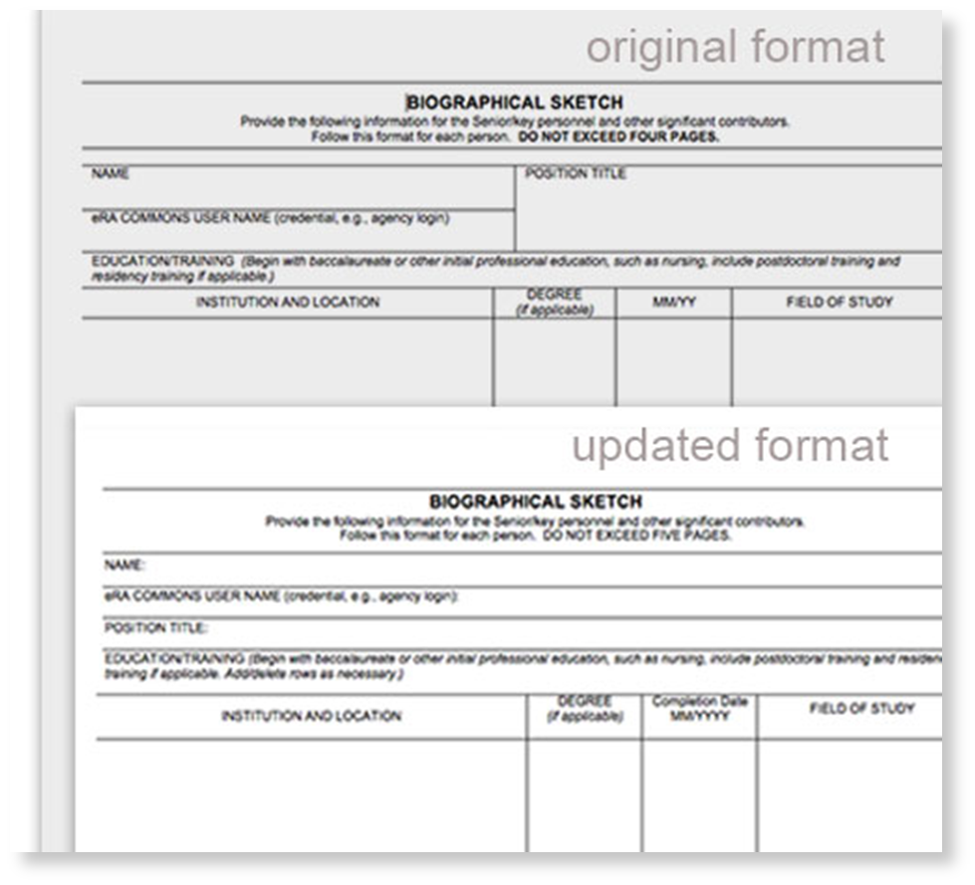
New Biosketch Format
Required as of May 25, 2015

Slide 20
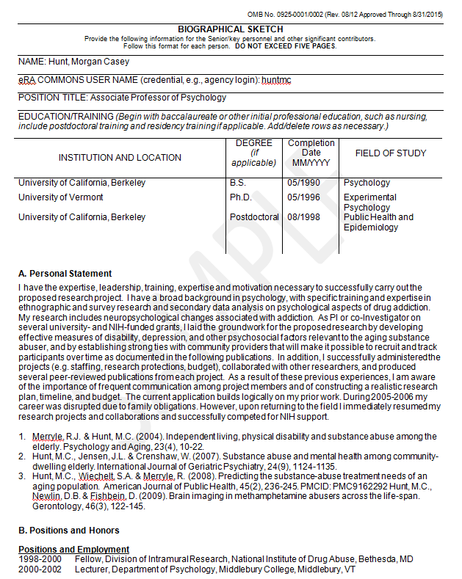
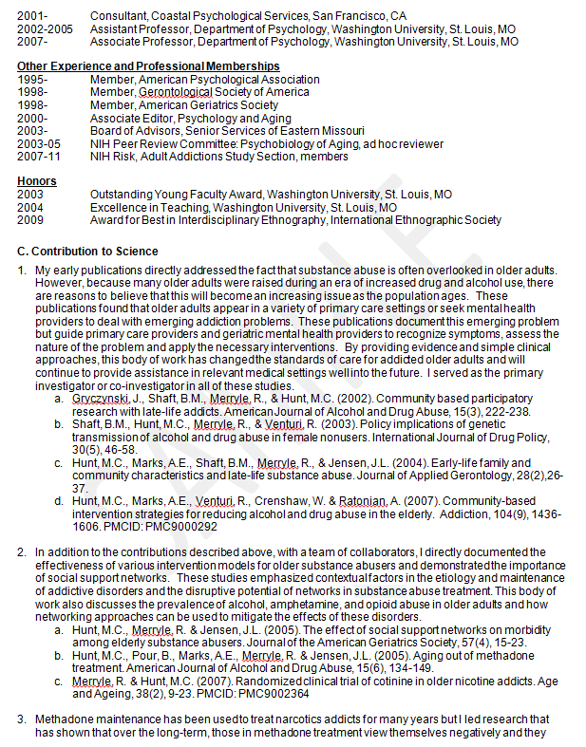
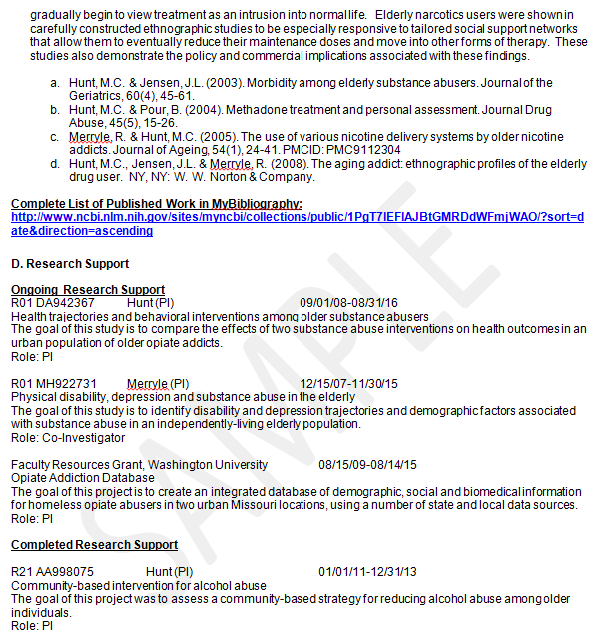
New Biosketch Format: Four Sections
A - Personal Statement
B – Positions and Honors
C – Contributions to Science
(option to include URL to List of Publications)
D – Research Support

Slide 21
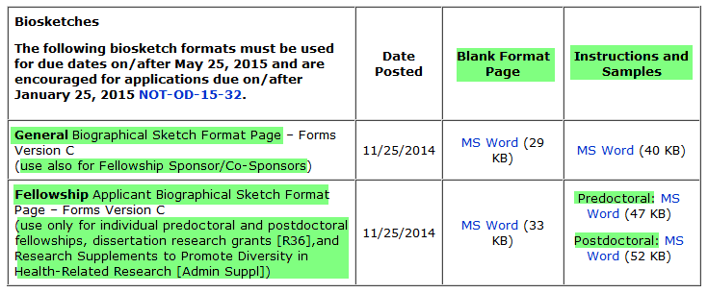
Two Biosketch Formats
General
Fellowship (predoc and postdoc)
http://grants.nih.gov/grants/funding/424/index.htm#inst

Slide 22
Expired Forms?
New forms available ~March 2016.
Watch for NIH Notice re: updated forms.

Slide 23
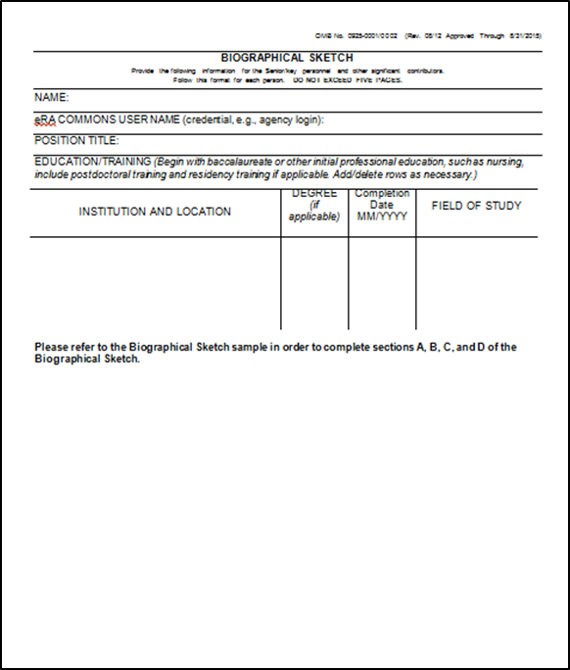
Two Options for Creating a Biosketch
Word Template
SciENcv tool from NCBI

Slide 24
Reviews for Rule Compliance
Biosketches are subject to two reviews for rule compliance:
Automatic preliminary review by eRA Systems upon initial submission
Manual review post-submission

Slide 25
Rule Compliance: Validated by eRA Systems
A Biosketch is required for each Senior and Key person listed in the application.
Five page limit.
PDF format.
NOTE: These three rules are validated by eRA Systems.
Failure to meet these conditions will result in a submission error preventing your application from moving forward to NIH for consideration.
Source:
Biosketch FAQs
Notes:
All other aspects of biosketch compliance are manually checked post-submission.

Slide 26
Rule Compliance: Validated by Manual Review
Do not include information, such as preliminary data, that belongs elsewhere in the application.
Complete each section
A - Personal Statement
B – Positions and Honors
C – Contributions to Science
D – Research Support
Limit of five Contributions to Science with no more than four citations per contribution.
Half page limit for each Contributions to Science (including citations). About 28 lines represents a half page (Arial, size 11 with narrow margins).
NOTE: Manually reviewed post-submission. Failure to follow the biosketch policy means NIH may withdraw your application from consideration.
Sources:
SF424 (R&R) Application Guide
Biosketch FAQs

Slide 27
Rule Compliance: Validated by Manual Review
Font types allowed (as of October 2015):
Arial
Helvetica
Palatino Linotype
Georgia
Font size 11, color: black.
Narrow margins (0.5”) on all sides; paper size no larger than 8½ x 11.
NOTE: Manually reviewed post-submission. Failure to follow the biosketch policy means NIH may withdraw your application from consideration.
NOTE: New guidance on font types and sizes available ~March 2016; effective May 25, 2016.
Source:
SF424 (R&R) Application Guide

Slide 28
Forthcoming Rules: Effective May 25, 2016
URL to List of Publications must be to a gov. website (My Bibliography). The List of Publications will remain optional.
No figures, tables or graphics.
Citations to non peer-reviewed journal articles and other “research products” can be included in the Personal Statement.
NOTE:
Effective May 25, 2016.

Slide 29
Contributions to Science: Instructions
Briefly describe up to five of your most significant contributions to science.
For each contribution, indicate:
historical background that frames the scientific problem
central finding
influence of the finding on the progress of science, health or technology
your specific role in the contribution

Slide 30
Contributions to Science: Recommendations
Tailor your contributions to the application.
The contributions are a descriptive narrative (“telling a story”) of your research efforts and a means of annotating your research products.
Your contributions are about your career and accomplishments.
What scientific problem did you research?
What were your findings or research products?
What was the impact of the findings?
What was your role?
Contributions can be in any order; chronological, career trajectory, funded projects, topic, relevance to the application, etc.

Slide 31
Publications and Research Products
Peer-reviewed articles
Non peer-reviewed articles (e.g., trade publications)
Posters and abstracts
Audio or video products
Patents
Data and research materials
Databases
Educational aids or curricula
Instruments or equipment
Models
Protocols
Software or netware
Etc.
Personal Statement:
Optional; up to four citations allowed (must be peer-reviewed journal articles. As of May 25, 2016: can include other research products).
Contributions to Science:
Required; up to four citations allowed
for each contribution.

Slide 32
Publications and Research Products: Instructions
NIH requires a PMCID for publications that apply under the NIH Public Access Policy and are authored by the applicant or arise from an applicant’s NIH award.
No specific style guide for citations required.
To save on space for contributions, applicants may use ‘et al’ in lieu of listing all authors in a citation.
Only published or accepted for publication material can be cited in the Personal Statement or contributions. Nothing in preparation or under review can be cited (but can be described in the narrative portions, e.g., “I am preparing a manuscript about my work about X”).
Citations can be reused among the Personal Statement or contributions.
Applicants do not need to be an author to a citation noted for the Personal Statement or contributions.

Slide 33
Biosketch: General Recommendations
Follow the NIH instructions/requirements for creating a biosketch. NIH and the reviewers are looking for specific information in a standard format.
It takes longer to prepare a new biosketch than anticipated.
Start early and get feedback before submitting.
Tailor the biosketch to the application.
“You are not your research but you are your biosketch.” Think of the biosketch as your scientific autobiography. Tell a story about your research and support it with evidence (research products).
Use Plain Language and avoid jargon. Plain Language is clear, concise, organized, and appropriate for the intended audience.

Slide 34
NCBI: My Bibliography and SciENcv

Slide 35
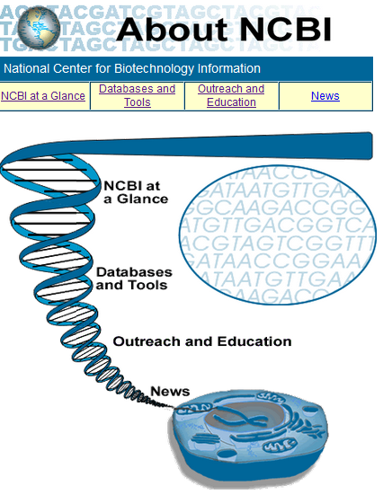
NCBI
The National Center for Biotechnology Information (NCBI) advances science and health by providing access to biomedical and genomic information.
Among the resources included are PubMed, PubMed Central, genomic tools, registries, databases, among others.

Slide 36
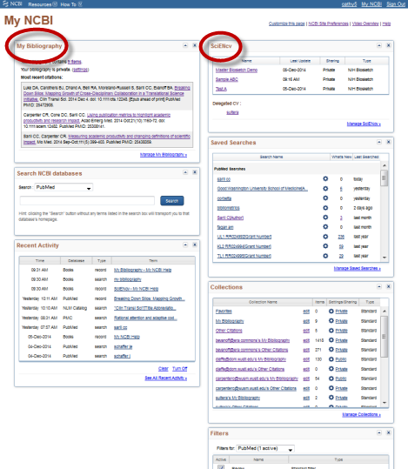
My NCBI
My NCBI is a dashboard that retains user information and database
preferences to provide customized services for NCBI databases.
Two specific tools include:
My Bibliography: (required as of 2010)
Bibliography of research products
RPPR
Auto-populate citations for a Biosketch created using SciENcv
Create link for URL to List of Publications
SciENcv: (optional)
“Links” to eRA Commons and MyBib
Create and save Biosketches
Auto-formats citations from MyBib
My NCBI Dashboard

Slide 37
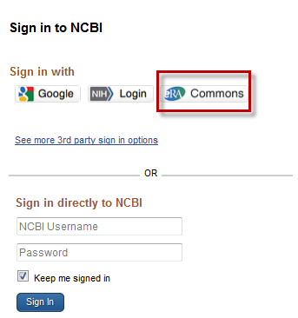
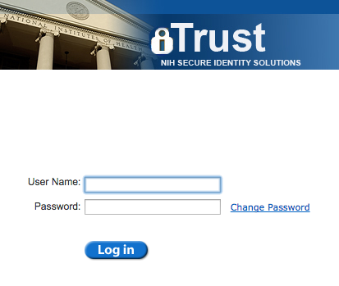
Link My NCBI to Your eRA Commons
Investigators:
Link your NCBI account to eRA Commons:
1. Go to: https://www.ncbi.nlm.nih.gov/account/ and select the eRA Commons button. Enter eRA Commons username and password.

Slide 38
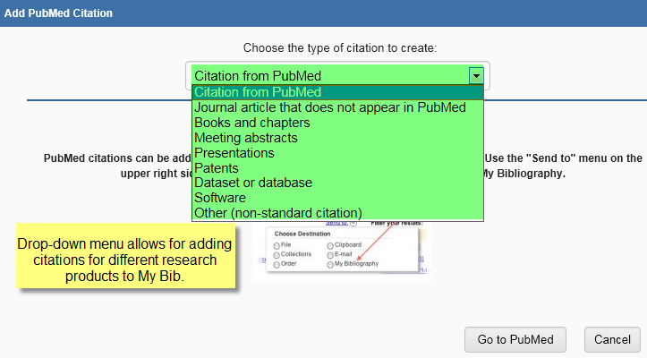
Add Citations to My Bibliography

Slide 39
SciENcv: Features
Biosketches can be auto-populated via eRA Commons and citations from My Bibliography.
Citations are auto-formatted and updated (NIHMSID and PMCID).
Biosketches can be created, deleted and saved (no limit on #).
Delegates can be assigned to create, modify or delete biosketches.
Add content once, use many times.
NSF Biosketch format also available.

Slide 40
SciENcv: Notes
SciENcv is not required for generating a new biosketch.
Use of auto-populated content is optional and can be edited.
Biosketches can be exported in PDF, Word, or XML.
SciENcv does alert users if a biosketch exceeds five pages when exporting a biosketch file into Word or a PDF.
Format of a Word file exported from a SciENcv biosketch:
Narrow margins (0.5”) on all sides
Arial font type, size 11
About 28 lines represents a half page

Slide 41
My NCBI: General Recommendations
Update and link your eRA Commons account to My NCBI.
Populate your My Bibliography with citations to publications and research products to use for URL to List of Publications to a gov. website (optional).
Play around with SciENcv. See how the new Biosketch can be auto-populated via eRA Commons and My Bibliography.
Consider a hybrid approach of using the Word Template and SciENcv.
Assign delegates to help manage your My Bibliography and SciENcv.

Slide 42
What Questions Do You Have?

Slide 43
Thank you
Cathy Sarli: sarlic@wustl.edu
Amy Suiter: suitera@wustl.edu

Slide 44
NIH: Templates, Instructions and Guidance
Instructions, Templates and Samples
http://grants.nih.gov/grants/funding/424/index.htm#biosketch
Biosketch FAQs
http://grants.nih.gov/grants/policy/faq_biosketches.htm
SF424 (R&R) Application Guide
http://grants.nih.gov/grants/funding/424/SF424_RR_Guide_General_VerC.pdf
Table of Page Limits
http://grants.nih.gov/grants/forms_page_limits.htm
NIH & AHRQ Change Font Guidelines for Applications to Due Dates On or After May 25, 2016
http://grants.nih.gov/grants/guide/notice-files/NOT-OD-16-009.html

Slide 45
Becker Library: Links
NIH Biosketch
http://beckerguides.wustl.edu/NIH_Biosketch
My Bibliography
http://beckerguides.wustl.edu/nihpolicy/mybib
SciENcv
http://beckerguides.wustl.edu/authors/sciencv
NIH Policy
http://beckerguides.wustl.edu/nihpolicy
URL to List of Published Works
http://beckerguides.wustl.edu/NIH_Biosketch/URL

Slide 46
Clinical Research Training Center
Office of Training Grants
Open Forum
Discuss common challenges and needs, future discussion topics and potential speakers

Slide 47
Clinical Research Training Center
Office of Training Grants
Office of Training Grants (OTG)
crtc.wustl.edu/otg
Contacts:
Mario Castro, MD, MPH, Director Office of Training Grants
castrom@dom.wustl.edu
Betsy Abente, MPH, Research Administrator
babente@dom.wustl.edu

